Slide 1
Opportunities for Checkpointing in CANDLE
ECP Annual Meeting, Houston, TX February 6, 2020
Justin M Wozniak Data Science & Learning
Argonne National Laboratory
woz@anl.gov
www.ExascaleProject.org

Slide 2
CANDLE Background
DOE-NCI Partnership
Joint Design of Advanced Computing Solutions for Cancer (JDACS4C)
Cancer Moonshot & National Strategic Computing Initiative
ANL, LLNL, LANL, ORNL, and Fredrick National Lab for Cancer Research
Accelerate precision oncology capabilities
3 application-focused Pilots
2 cross-cutting initiatives
Uncertainty quantification
Scalable deep learning (CANDLE)
NCI
National Cancer Institute
Computing driving cancer advances
DOE
Department
of Energy
Cancer driving computing advances

Slide 3
Project Goals
Provide API for deep learning on DOE supercomputers
CANDLE Library
Facilitate dependencies, IO, UQ, visualization, profiling
Support general set of deep learning workflows
CANDLE Supervisor
Portable across DOE computing platforms
Produce example proxy application models for vendors and users
CANDLE Benchmarks
Pilot-based deep learning models

Slide 4









Deep learning on supercomputers
Steep learning curve with myriad technologies
Workflow manager (Swift/T, EMEWS) ; Scheduler ; Scripting
Deep learning (Keras, TensorFlow, Horovod)
Optimization algorithms (R, Python)
MPI implementation (MVAPICH, Open MPI) – or other communication
etc. …
4

Slide 5
CANDLE/Supervisor Workflow Goals
Develop an exascale deep learning environment for cancer
Building on open source deep learning frameworks
Optimization for CORAL and exascale platforms
Support all three Pilot project needs for deep learning
Collaborate with DOE computing centers, HPC vendors and ECP co-design and software technology projects
Mission statement: Enable the most challenging deep learning problems in cancer research to run on the most capable supercomputers in the DOE
Provide a path forward for machine learning applications at the largest scale…

Slide 6
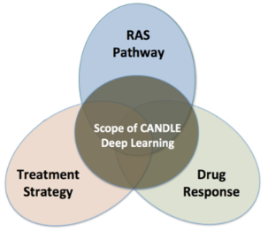
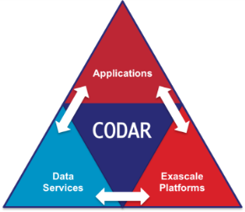
Previous work: Advanced data management
Swift/T training workflow
CANDLE workflows produce a great number of medium-sized ML models
Goal: Cache these on compute node storage for possible later use
Need to flush to global FS before end of run, but many models will be discarded
Accomplishment: Integrated Swift/T workflow system used in CANDLE with DataSpaces client
Accelerate CANDLE workflow performance, enable novel training strategies (parameter sharing)
Wozniak et al. Scaling deep learning for cancer with advanced workflow storage integration. Proc. MLHPC @ SC 2018.
CANDLE benchmark
CANDLE
…
TensorFlow
TensorFlow
Good NN model
DataSpaces Services
Parallel FS

Slide 7
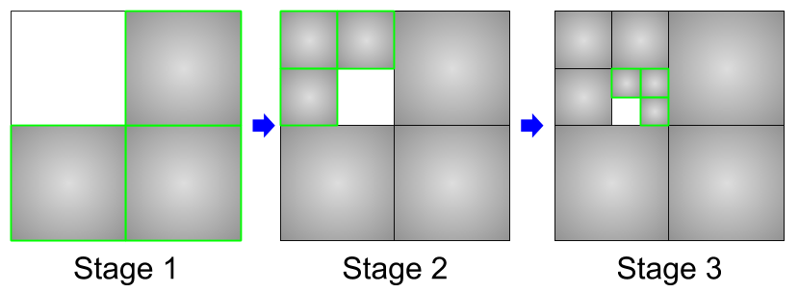
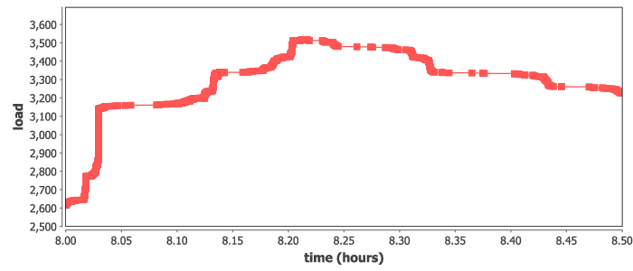
New work: Data analysis workflow
Split up the training data into subsets, iteratively train on most remaining subsets.
Weight sharing from one subset to the next (incremental learning)
Allows for investigations into data quality and learning patterns
Could also boost performance by preventing overloading data ingest limits
Recursive calls define the datasets for training
Runs at large scale on Summit, ramp-up/down
Many models are written and read
run_stage(int N, int S, string this, int stage,
void block, string plan_id) {
void parent = run_single(this, stage, block, plan_id);
if (stage < S) {
foreach id_child in [1:N] {
run_stage(N, S, this+"."+id_child, stage+1, parent,
plan_id, db_file, runtype);
}}
}
run_single(string node, int stage, void block) {
json_fragment = make_json_fragment(node, stage);
json = "{\"node\": \"%s\", %s}" % (node, json_fragment);
block => obj(json, node);
}

Slide 8
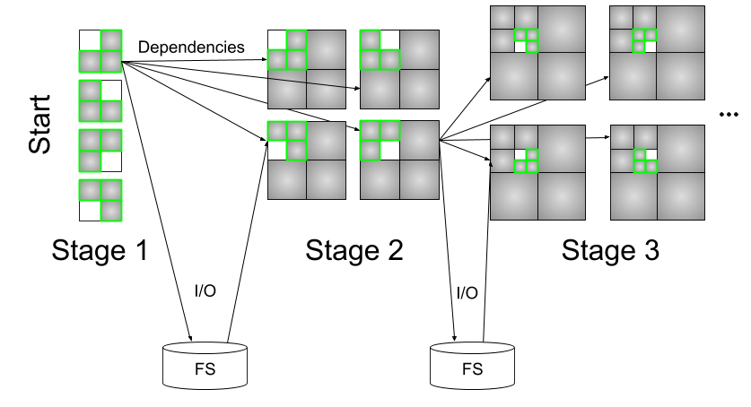
Workflow structure and checkpoint/restart pattern
Want to start child runs as soon as parent is complete (not whole stage)
Store/load model weights files ~200 MB/minute/node (will increase)

Slide 9
Thanks
Thanks to the organizers
Code and guides:
CANDLE GitHub: https://github.com/ECP-CANDLE
Swift/T Home: http://swift-lang.org/Swift-T
EMEWS Tutorial: http://www.mcs.anl.gov/~emews/tutorial

Slide 10
Questions?

Slide 11
Acknowledgments
This research was supported by the Exascale Computing Project (ECP), Project Number: 17-SC-20-SC, a collaborative effort of two DOE organizations - the Office of Science and the National Nuclear Security Administration, responsible for the planning and preparation of a capable exascale ecosystem, including software, applications, hardware, advanced system engineering and early testbed platforms, to support the nation's exascale computing imperative.
www.ExascaleProject.org

